Slide 1
Designing a Metadata Repository
Chris Nelson
Metadata Technology
Work Session on Statistical Metadata Geneva 6-8 May 2013

Slide 2
Roadmap
What type of metadata
Major issues facing designers of metadata repositories
How these can be overcome
Concentrates on SDMX
as this is the standard supported by the Metadata Technology metadata repository
but many of the issues and the solutions are generic to any approach that supports a standard metadata model
Concentrates on data dissemination
and how to combine the data points to the metadata that are relevant

Slide 3
What Type of Metadata
What SDMX calls “referential metadata”
sometimes known as “footnote metadata”
Often used in data quality frameworks
ECB
Eurostat
ILO
IMF SDDS and GDDS
OECD
Many others

Slide 4
Problem Statement
We are building a metadata repository to support the metadata model of SDMX
the repository is therefore not built to support user requirements specific to an individual organisation
it is built to support the genericity of metadata that can be authored, stored, queried, and made available with the SDMX constructs and data points to which they relate
Most problems stem from the need to support a standardised metadata model
it is important not to deviate from the model
There are many models for metadata
but few of them support discovery, query, and retrieval of metadata
SDMX has a strong and generic model for (reference) metadata

Slide 5
Problem Statement
SDMX has strong support for data query
both simple (REST) queries and more complex (SOAP) queries
but no real support for simple metadata queries
little real support for combining metadata with data points in the same “message”
But applications (e.g. web clients) want simple mechanisms
to know what metadata are relevant to the data points
to retrieve the metadata
to process the metadata
in general XML is NOT friendly for web clients

Slide 6
Design Issues
How to query for metadata?
in SDMX the standard is very clear on how to query for data
but there is no equivalent simple query format for metadata that lends itself to use by web clients.
What should the metadata repository return when queried?
should this be a link to the metadata or the actual metadata?
How is the web client informed of the presence of metadata?
should this be separated from the data set or embedded with the data, even though it was authored independent of the data?
Does the data store need to know about the metadata repository?
or can the data store be totally de-coupled from the metadata repository?

Slide 7
Design Issues
How does the application know precisely to which object metadata is attached?
it is simple to attach metadata to data as data has a precise key
but metadata related to structural metadata can be more complex
careful thought needs to be given to validating that the “context” of the metadata is well understood
What input and output formats should be supported for the metadata?
for SDMX systems clearly SDMX will need to be supported but there are other more web friendly formats such as JSON (Java Script Object Notation)
How to attach the same metadata to multiple objects?
metadata often travels through the statistical lifecycle and may be used by multiple artefacts in this lifecycle

Slide 8
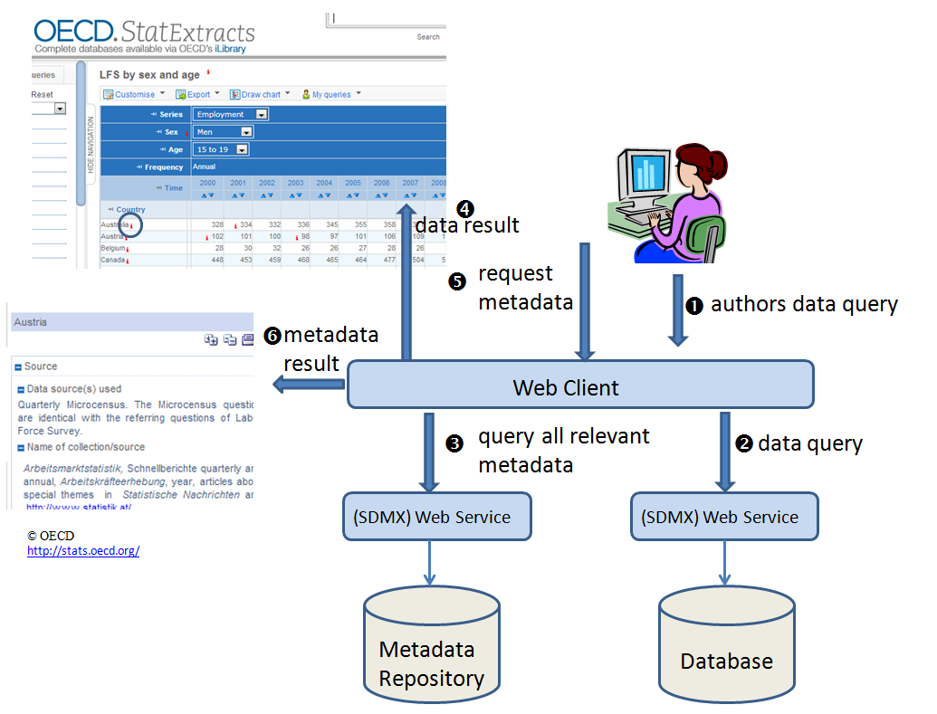
Query for Metadata – Scenario 1
The web client queries for the data, obtains the result,  determines the “key” for each possible point at which metadata can be available, and queries the metadata repository for all these points.
The web client places an “i” at the point at which there is metadata.
When the user clicks on the “i” the web client retrieves the metadata.
 The metadata is returned.

Slide 9
Query for Metadata – Scenario 1
The disadvantages of this approach are:
The web client needs know how to query for the metadata.
The web client needs to make multiple queries to the metadata service, one for each data point.

Slide 10
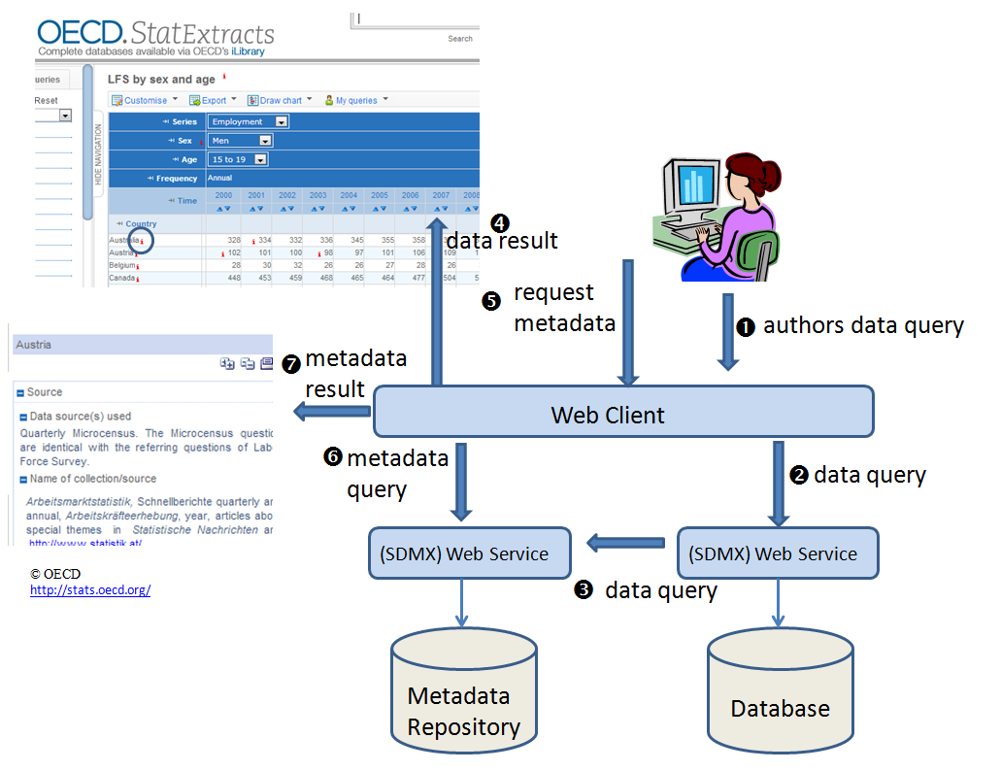
Query for Metadata – Scenario 2
The web client queries for the data.
The same data query is passed to the metadata repository and the data service annotates the data response with the metadata points.
The web client receives the response, and can use the metadata points to indicate to the user (“i” ) that extra metadata is available.
When the user wishes to view the additional metadata, the web client makes an additional query to the metadata repository.
The metadata is returned.

Slide 11
Query for Metadata – Scenario 2
The disadvantages of this approach are:
The database needs to know about the metadata repository, it needs to query the metadata repository, and it needs to know how to interpret the response and embed the information into the dataset.
It is not possible to retrofit the metadata repository onto existing data web services without enhancing the data web service.

Slide 12
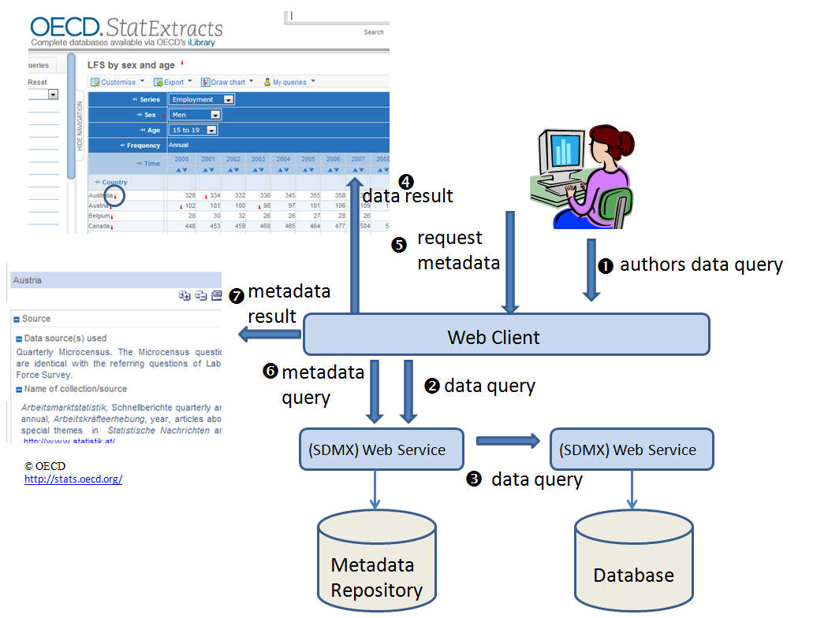
Query for Metadata – Scenario 3
Looks similar to Scenario 2 but architecture is different
Here the metadata repository is in charge and  It passes the data query to the database.
The metadata repository enhances the data response with the metadata points.
- as for scenario 2.
Advantage of this approach
The metadata repository can be retro-fitted to existing database systems because the database does not need to have any knowledge of the existence of the metadata repository.

Slide 13
Unite the Metadata with the Data
Remember
we must conform to the SDMX Information Model
SDMX has
Data Set for data
Metadata Set for metadata
(Structure message for structural metadata)

Slide 14
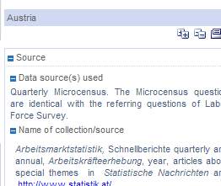
A Not Very Friendly Response
Application
Here’s some data for LFS by Sex and Age for employment of men aged 15-19 for all countries
There may be some metadata, but this will be in a separate message
Here’s some metadata. It relates to country=Austria in the context of LFS by Sex and Age. Find the data and sort it out yourself

Slide 15
A More Friendly Response
Application
Here’s some URLs of related metadata. I’ve put them next to the data points to which they refer, or in the data set section if the metadata refer to many data points.
If you go to the URL you will get the metadata
Here’s some data for LFS by Sex and Age for employment of men aged 15-19 for all countries
This can be embedded in the SDMX data set using Annotations
Remember, we are talking about the Information Model, not the specific syntax used to represent this. This could XML, or JSON, or CSV(!), or any syntax that supports the model

Slide 16
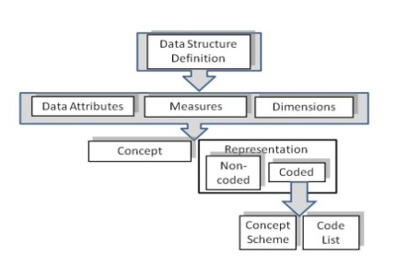
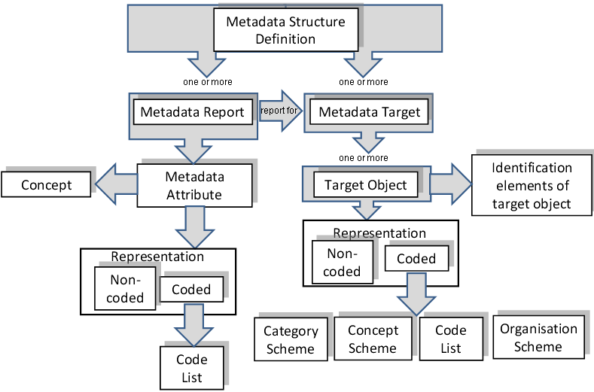
Concept Scheme
Data or Metadata Structure Definition
Concept
Category Scheme
Structure and Item Scheme Maps
Data or Metadata Flow
Categorisation
Category
Data Provider Scheme
Content
Constraint
Provision Agreement
Data Provider
Attaching Metadata to Non-Data Points
All these points are valid
Register
Registered Data Set or Metadata Set

Slide 17
Concept Scheme
Attaching Metadata to Non-Data Points
This union has no semantic meaning in the SDMX Information Model
So it has no meaning for a metadata repository supporting the semantics of the Information Model
Concept
Data Provider Scheme
Data Provider
But it may be meaningful for an individual organisation and so the SDMX Metadata Structure Definition (MSD) allows this type of union.
However, the generic metadata repository cannot support this and must ensure such MSDs are not defined or used in the repository

Slide 18
Storing, Indexing, Retrieving, Metadata
Metadata needs to be identified uniquely and to be found easily.
a lot of metadata is textual in nature
this is often better supported in a NoSQL database which has good in-built indexing and textual query support
Metadata may be versioned
draft and final versions
metadata for different reporting periods
Metadata may be shared between different objects
this is quite common for metadata supporting processes
This means the metadata repository needs to separate the actual metadata from the way it is indexed

Slide 19
Summary
Get the design right by knowing up front the user requirements and the problems these may reveal
Designing a generic solution that supports a specific standard (or even multiple standards) is more difficult than a solution for a specific organisation
There will always be specific user requirements that will “test” the robustness of the solution
But the robustness of the design will be helped if the design is based on a strong model for metadata

