Slide 1
PUBLIC ACCCESS TO PRTR: WORKERS’ STANDPOINT
Begoña María-Tomé Gil

Slide 2
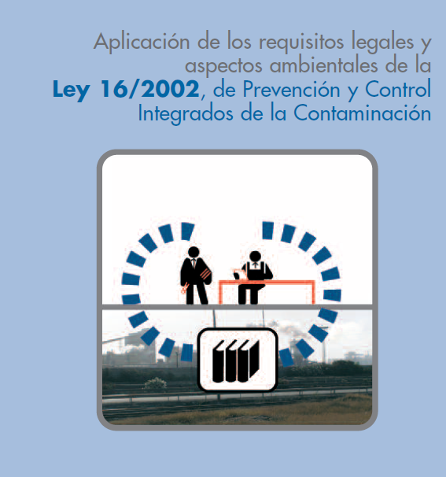
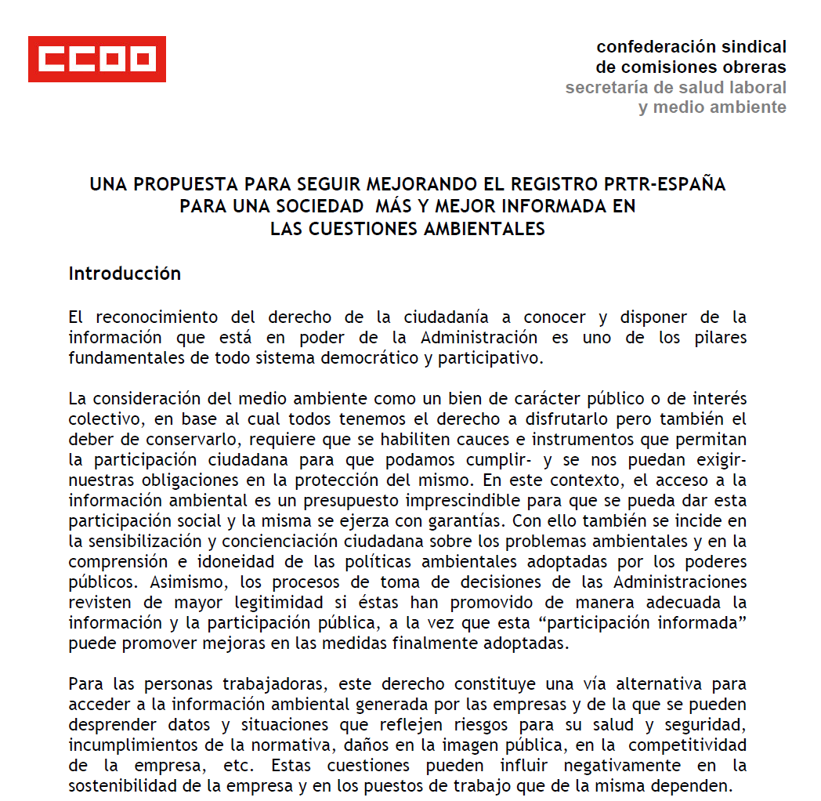
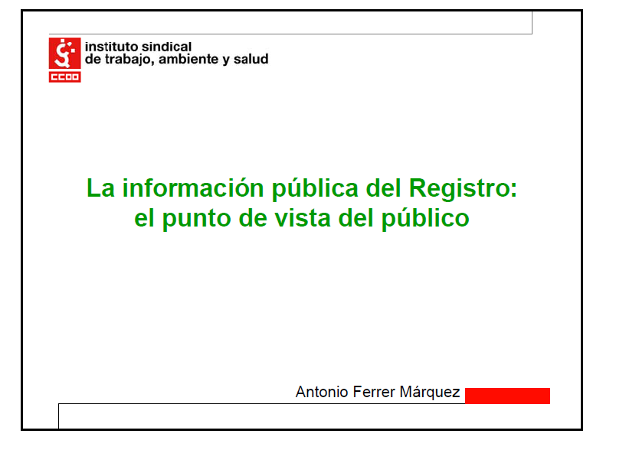
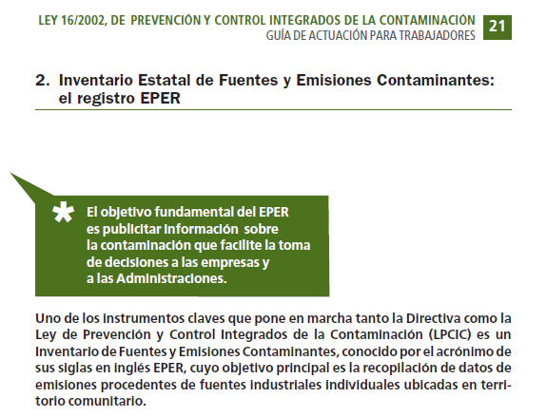
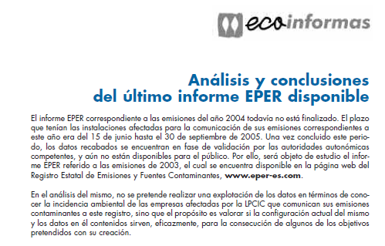
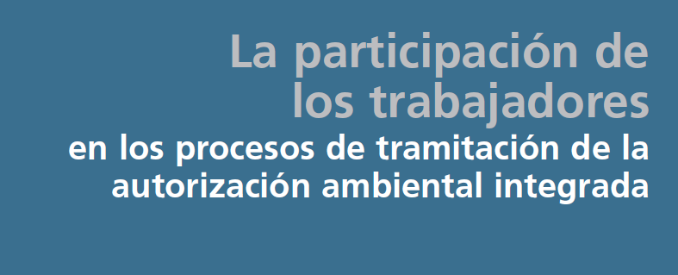
OUR WORK ON PRTR

Slide 3
WORKERS’ ACCESS TO PRTR
Environmental representatives: an awareness, information and environmental training tool
About?
How and were are pollutants generated?
Health and environmental risks
Prevention /control procedures and BAT
What for?
Monitoring of emissions and technical adaptation of facilities
Risk detection
Proposals for improvement
Participation in environmental management systems

Slide 4
OUR PROPOSAL TO IMPROVE PRTR
Increasing the information contained in the registry
Including all data in the emissions’ report
Introducing data on production, working hours, number of workers, and completing the environmental profile of facilities
Including Integrated Permits
Introducing reports deriving from environmental inspections
Achieving progress in comparing a facility’s performance with authorized values
Improving the quality of information by increasing the volume of measured or calculated data (not estimated data)
Providing information on saturated, sensitive or vulnerable areas

