Slide 1
INTERNATIONAL PRTR WEEK SPANISH BUSINESS EXPERIENCE Pedro Mora – Vice Chair Sustainable Development and Environment Committee of CEOE
Madrid, 25 november 2015

Slide 2
Is PRTR useful? …
STANDARDIZATION OF METHODOLOGIES
COMPARABILITY OF DATA
GREATER UNIFORMITY OF CRITERIA
LACK OF COORDINATION
AVOID DUPLICITIES

Slide 3
PRTR doesn´t have in account…
PRODUCTION LEVELS
MISINTERPRETATION
INFORMATION
POTENTIAL IMPACT SUBSTANCE
POTENTIAL POLLUTION INSTALATIONS
DISTORSION PUBLISHED INFORMATION
WRONGFUL USE OF THE DATA

Slide 4
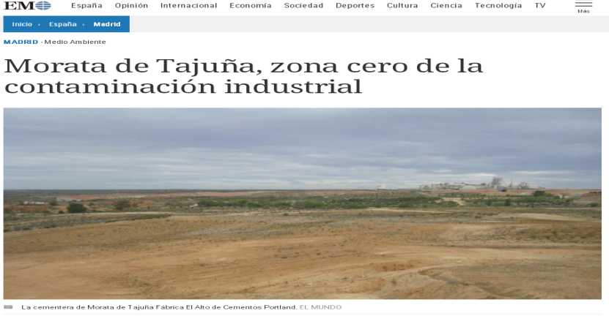
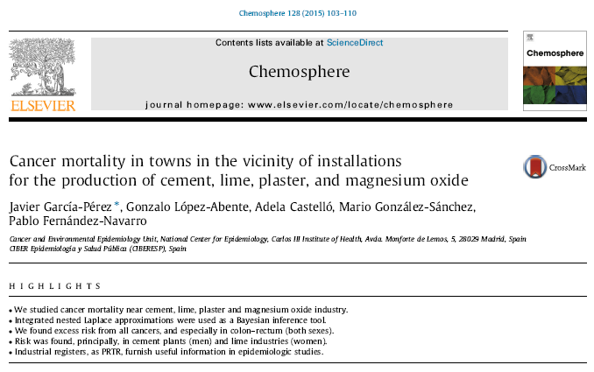
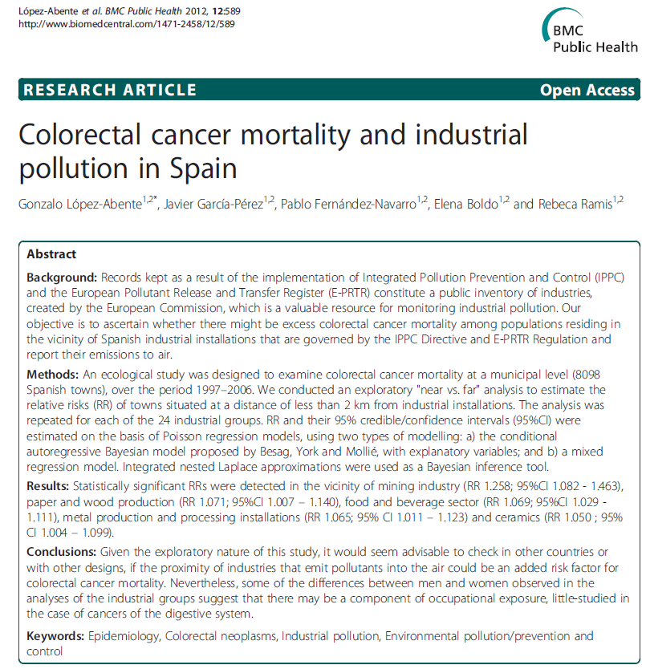
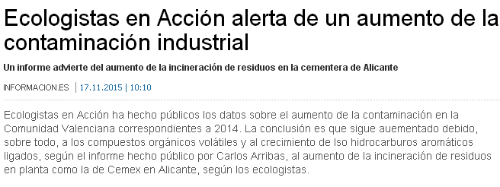
NEGATIVE CONSECUENCIES FOR THE INDUTRIES IN THE SOCIETY

Slide 5
ACTION IS REQUIRED…
Harmonized Methodology :
Sectorial guidelines
Same criteria between Autonomous Communities
Better information, formation and dissemination
Ensure data coherence with others Registers
Sharing responsability: private industries and competent authorities

