Slide 1
On the Use of the U.S. EPA’s Toxics Release Inventory to Assess Implementation and Impact of Green Chemistry Practices by the Pharmaceutical Manufacturing Sector
Stephen C. DeVito, Ph.D., R.Ph.
Toxics Release Inventory Program
United States Environmental Protection Agency
Presented at:
2nd Global Round Table on Pollutant Release and Transfer Registers
Madrid, Spain
November 25th, 2015

Slide 2
Overview
Many examples exist that describe green chemistry successes
Can EPA’s Toxics Release Inventory (TRI) be used as a tool to measure this progress?
More broadly, can PRTRs be used as a tool to evaluate the impact of green chemistry practices and progress toward sustainability goals?
Notes:
From numerous publications, from EPA’s Green Chemistry Awards, as well as from the two presentations you’ve already heard, it’s clear that there have been significant advances in Green Chemistry. To confirm this, we searched the published literature for articles highlighting different types the green chemistry successes. We found many publications on specific green chemistry advances. As these Green Chemistry successes reduce toxic chemicals, we should be able to see these results reflected in the TRI data. We set out to examine if you could, in fact, see the reductions from Green Chemistry in the TRI data, and could then use TRI as a tool to measure GC progress. To do this, we selected a sector and conducted a case study or test case, as a step in determining if we can more broadly use TRI as a tool to evaluate progress toward sustainability goals.

Slide 3
Green Chemistry in Pharmaceuticals
Many examples in literature
Pfizer identified a greener synthesis of sildenafil citrate (ViagraTM)
Merck and Codexis developed a green synthesis of sitagliptin, the active ingredient in Januvia™, a treatment for type 2 diabetes.*
Pfizer developed a sustainable biocatalytic process for making Pregabalin, the active ingredient in Lyrica®, which is used to treat neuropathic pain.*
*Received EPA’s Presidential Green Chemistry award
Notes:
We focused on the pharmaceuticals sector because: 1) There were many green chemistry examples in the literature, including several pharmaceutical companies that had received the EPA’s Presidential Green Chemistry award; and 2) green chemistry progress seemed to be widespread in the sector.

Slide 4
Approach
Examined trends in TRI releases by the pharmaceuticals sector
Examined likely drivers for the trends observed:
Economic trends
Outsourcing
Regulations
Shifts to other waste management practices
Influence of large firms
For the complete analysis, see:
S.C. DeVito, C. Keenan and D. Lazarus: Green Chemistry, volume 17, pages 2679-2692 (2015)

Slide 5
Large reductions in release and other waste management quantities observed.
Similar trend in waste managed indicates real reductions
Notes:
Did wastes shift from releases to other waste management methods? For example, are releases going down because more of the wastes are being treated rather than released? If green chemistry is implemented, you would expect to see a reduction in releases AND in waste managed, rather than a shift because through GC, less of the toxic chemical would be used and less waste would be generated in the first place. The blue line shows the quantities of waste managed, which also includes releases, in addition to other quantities managed as waste such as the pounds recycled, used for energy recovery, and treated. The pounds of waste managed dropped from about 480 million pounds in 2002 to about 180 million pounds in 2011. This indicates a real reduction in waste generated rather than a shift in management methods.

Slide 6
Does the trend reflect general improvements seen across sectors?
The decline in releases for pharmaceuticals facilities is much greater than the trend for the rest of manufacturing industry
Notes:
Next we asked if the downward trend in pharmaceuticals is part of an overall downward trend seen throughout TRI-reporting sectors. To look at this question, we compared the trend for pharmaceuticals to that of all other manufacturing industries. We see a 29% decline in releases for the rest of manufacturing compared to the 67% decline in pharmaceuticals, a considerably greater decline, indicating that there’s something more going on in pharmaceuticals than we see elsewhere.

Slide 7
Are reductions due to economic trends?
Changes in annual value-added has little impact on the release trend
Notes:
Next, we looked to see if the reductions were due to economic trends – if production declined by 67%, then a 67% reduction in releases would indicate no change at all in releases per unit of product manufactured. Here we take the annual value added for pharmaceutical manufacturing. The value added for the pharmaceutical industry decreased by 2% between 2002 and 2011, while over the same time interval releases of toxic chemicals as reported to TRI decreased by 67%. This indicates that toxic chemical releases reported by the pharmaceutical industry decreased considerably more than can be accounted for by a change in production
levels over the same period of time.
Releases include onsite and offsite disposal or other releases
Value-added is from the U.S. Census Bureau and is shown in 2011 $

Slide 8
Are reductions a result of outsourcing?
All Pharmaceutical Sector Reporters
Facilities Reporting All Years
Facility-Chemicals Reporting All Years
Facilities that reported continuously over the 10-year period reduced releases as much as the entire sector
Notes:
During the time period examined, outsourcing of manufacturing or portions of manufacturing operations to foreign locations has taken place across many manufacturing sectors, including in the pharmaceutical industry. Next we looked to see if outsourcing was driving the declining trend observed. That is, total releases from U.S. facilities are expected decrease as manufacturing activities shift outside the U.S., since these outsourced facilities are not required to report to EPA’s TRI Program. The publicly available data on outsourcing are limited. To examine this potential factor, we looked at only those facilities which filed TRI reports to EPA’s TRI Program every year from 2002 through 2011. By doing so, the influence of reports from facilities that may have closed due to outsourcing, and therefore stopped reporting to TRI, are eliminated from the trend line. This trend is depicted by the green line and it shows a decline in releases of 61%, very similar to the overall decline. Next, for those facilities that reported every year, we only included those chemicals that were reported every year. In doing so, the influence of processes within the facility that were outsourced over the time period examined is eliminated from the trend line. This line does show a 42% decline which could indicate outsourcing is a contributor, although of the analyses conducted, this one is the least definitive as to cause and effect. Without more specific outsourcing data, however, we can’t eliminate outsourcing as a contributor, but we can show it’s not likely a driving force.

Slide 9
Are reductions sector-wide or driven by a few companies?
Entire Pharmaceutical Industry
Top 3 Companies
Other Pharmaceutical Facilities
Reductions are sector-wide
Notes:
Next, we wanted to determine whether the observed reductions are being driven by a few companies or are a sector-wide phenomenon. While the sector as a whole saw releases of 67%, even with the top 3 companies are removed, the rest of the sector still saw considerable reductions, as shown here by the 61% reduction for the green line, representing all facilities other than those of the top 3 companies. This indicates that the reduction in toxic chemical releases is an industry-wide trend, and while dominated by the largest parent companies, substantial release reductions are occurring throughout the sector.

Slide 10
Are the chemicals driving the trend associated with green chemistry advances?
all other chemicals
five solvents
Solvents driving the declining trend: Methanol, Dichloromethane, Toluene, Dimethylformamide, Acetonitrile
Notes:
Are the chemicals that are being reduced those that you would expect to see reduced through the implementation of green chemistry activities? The published literature indicates that reductions in solvents are often expected through green chemistry projects, so we looked at the contribution of 5 solvents to the trend observed. These 5 chemicals account for 75% of the decline in releases and 76% of the WM decline. Methanol (42%, 45%), dichloromethane 21% 12%, toluene 7% 11%, dimethylformamide 3% acetonitrile 2%
Zn cpds, nitrate cpds, and HCl account for another 15% of the decline in releases (3rd, 4th and 5th greatest impact on the decline in releases) but only 5% of the WM decline

Slide 11
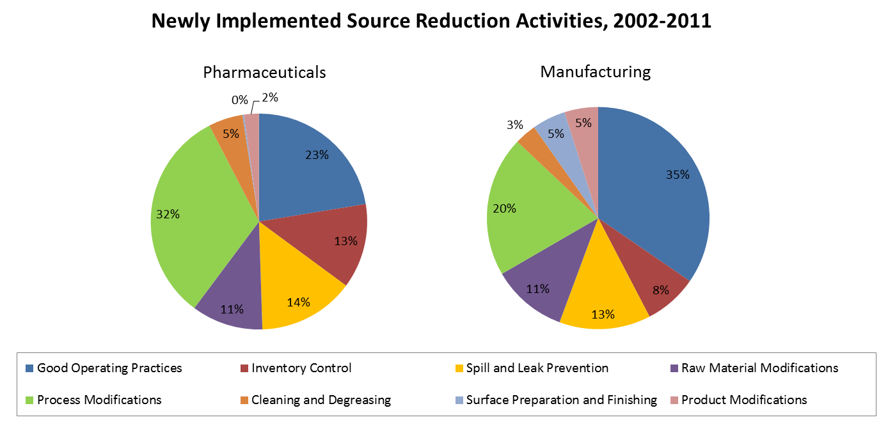
Pollution Prevention in TRI
Pharmaceutical facilities report more process modifications than the rest of manufacturing
Notes:
Facilities report their newly-implemented source reduction activities (Section 8.10) using codes that correspond to activities in eight major categories: the most common source reduction category reported to the pharmaceutical industry was Process Modifications. Many green chemistry activities, like increasing synthesis efficiency or reducing use of a process solvent, are included in this category. In contrast, the most commonly reported source reduction category in the manufacturing sector was good operating practices, a category much less likely to include green chemistry practices.

Slide 12
Wrap up
Can TRI data be used to quantify environmental progress?
The results of our analyses indicate that the implementation of green chemistry by the pharmaceutical industry is reflected in the TRI data
The results more broadly suggest a potential for the use of PRTR data as a tool to track implementation of green chemistry and sustainability progress.

Slide 13
Acknowledgements
Cheryl Keenan, MSc,
Senior Associate at Abt Associates, Cambridge MA
Dana Lazarus
Formerly of Abt Associates, Cambridge MA
S.C. DeVito, C. Keenan and D. Lazarus:
Green Chemistry, volume 17, pages 2679-2692 (2015)

