Slide 1
Strategy for sustainable housing and land management in the UNECE region for the period 2014 – 2020
Gulnara Roll, Head,
Housing and Land Management Unit
16 December 2013, Geneva

Slide 2
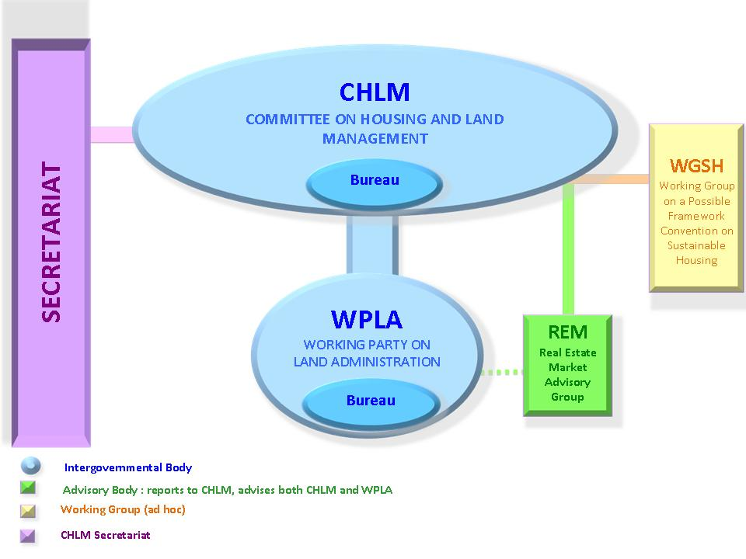
Structure of UNECE Committee on Housing and Land Management

Slide 3
Committee areas of work
Sustainable housing
Sustainable urban development
Land administration and management
Country profile on housing and land management

Slide 4
The process of the Strategy development
Committee Bureau agreed on the need of the Strategy at its meeting on 2 April 2012 and prepared the first draft.
First draft Strategy discussion at the 73rd Committee session, September 2012
The Committee decided on the structure of the Strategy and entrusted the Bureau with further developing the draft strategy.
Survey of opinions of member States in October – November 2012.

Slide 5
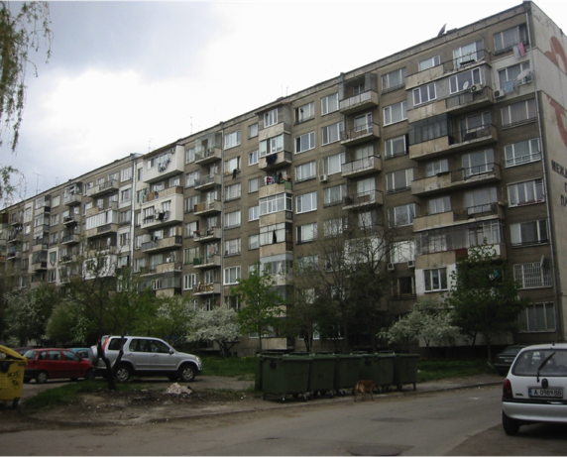
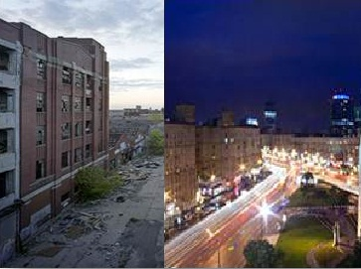
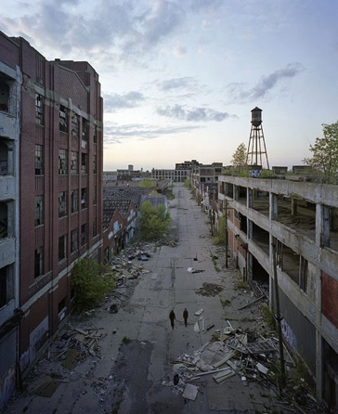
Outcomes of the survey:
key challenges
- High private ownership
- Deterioration
- Energy loss
- Affordability
TRANSITION FROM CENTRALLY PLANNED TO MARKET ECONOMY
- Unbalanced development
- Polarization
- Social and spatial
segregation
SIDE EFFECTS OF GLOBALIZATION
FINANCIAL AND ECONOMIC CRISES
- Homelessness
- Urban decline
- Abandoned sites

Slide 6
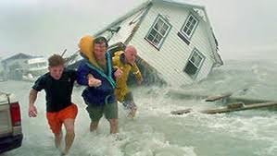
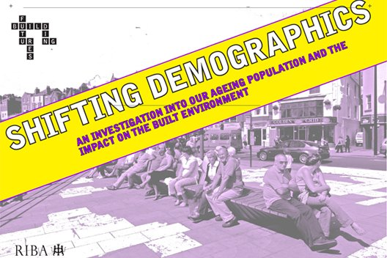
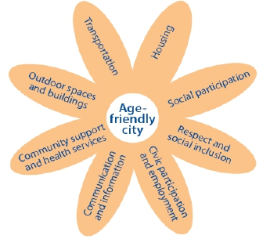
Outcomes of the survey:
key challenges
Loss of life,
assets and
economy
CLIMATE CHANGE
DEMOGRAPHIC CHANGES
Shifts in planning
and design

Slide 7
Consultations on the Strategy preparation
Meeting of the Bureau of the Committee, 28 Nov 2012
Stakeholders’ meeting, 18 February 2013
Joint bureaux meeting, 19 February 2013
Committee Bureau meeting, 20 February 2013
The draft Strategy sent to Committee, 5 April 2013
Informal meeting of the Committee agreed on the draft Strategy text, 21 May 2013.

Slide 8
MINISTERIAL MEETING HOUSING AND LAND MANAGEMENT 8 October 2013
240+ participants: 47 countries, 18 ministers,
8 vice-ministers and 31 agency heads
The Ministerial Meeting adopted the strategy, which will guide the work of the Committee, its Working Party on Land Administration and the Real Estate Market Advisory Group.

Slide 9
Vision
Sustainable housing and real estate
Sustainable urban development
Land administration and management
Cross cutting Issues
Objevtives (3)
Objectives (1)
Targets (6)
Objectives (2)
Targets (8)
Objectives (2)
Targets (5)
Targets (2)
Objectives (2)
Targets (5)
Objectives (4)
Targets (8)

Slide 10
The Strategy
The Strategy contains 15 objectives (A to N) and 36 targets.
These are organized under four themes:
Sustainable housing and real estate markets
Sustainable urban development
Sustainable land administration and management
Cross-cutting themes

Slide 11
The Strategy
Objective (A). To reduce energy use in the housing sector as compared to 2012 and continue the downward trend
Objective (B). To reduce the impact of the residential sector on the environment, taking into account the life cycle of buildings
Objective (C). To improve the resilience of buildings to natural and human-generated disasters

Slide 12
The Strategy
Objective (D). To improve the overall access of all to adequate, affordable, good-quality, healthy and secure housing and utility services, with particular attention to young people and vulnerable groups
Objective (E). To improve the access of persons with disabilities to barrier-free housing
Objective (F). To support and encourage private investment in the housing sector
Objective (G). To ensure efficient management of the housing stock

Slide 13
The Strategy
Objective (H). To contribute to well-functioning efficient, equitable and transparent housing and land markets which respond to different types of housing demand
Objectives (I). To balance the competing demand for and limited supply of available land, minimise the loss of rural land and increase the efficient use of urban land
Objective (J). To have in place an efficient, accessible and transparent land administration system, which provides all with security of tenure and real property rights, facilitates real estate investments and transactions and ensures effective and transparent property valuation, land-use planning and sustainable land development
Objective (K). To set up, or improve the performance of those organizations, such as land registries, cadastre agencies, courts and other public authorities which are essential for a well-functioning land administration system

Slide 14
The Strategy
Objective (L). To ensure investment in innovation and research, with particular attention to energy savings, social innovation, green, compact, inclusive and smart cities
Objective (M). To support good governance, effective public participation and the rule of law in the areas of housing, urban planning and management and land administration
Objective (N). To ensure that specific provisions on non-discriminatory processes are duly reflected in existing housing, urban planning and land management legislation
Objective (O). To intensify the regional and international exchange of experience and cooperation in the areas of housing, urban planning and land management

Slide 15
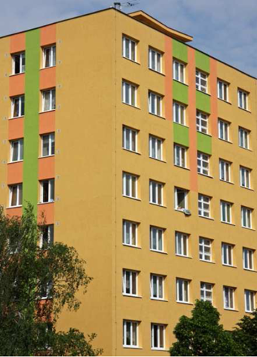
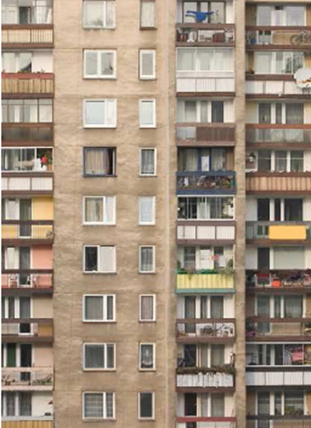
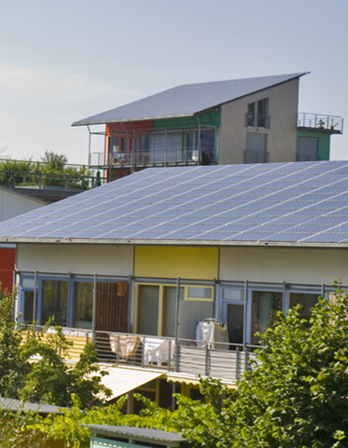
The strategy is available at:
http://www.unece.org/fileadmin/DAM/hlm/documents/2013/ECE_HBP_2013_3.pdf
Gulnara Roll, Head, UNECE Housing and Land Management Unit, E-mail: Gulnara.Roll@unece.org

