Slide 1


E-waste in EECCA countries
Dr. Kees Baldé
balde@unu.edu
c.balde@cbs.nl

Slide 2
United Nations University and Statistics Netherlands
Green Growth
Waste statistics
Environment Statistics
UNU: Think-tank of United Nations
  Our team - mainly e-waste
Statistical harmonization of e-waste measurement
Capacity building
  Kenya, China, El-Salvador, etc
  Training post graduate students and managers on e-waste management
  Etc.
Projects for national governments (USA, European Commission, Ethiopia, Japan, etc.)

Slide 3
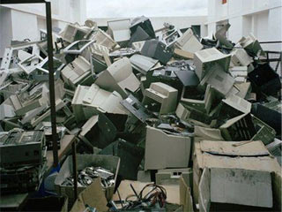
What is e-waste?
Everything with a plug or battery
Many appliances

Slide 4
Methodology: e-waste quantities
Comtrade trade database
Trade in HS codes per country analysed
  1995-2012
  175 countries
  260 HS codes
  Average weight
  Sales = import - export
Link to 54 product categories
Statistical routines
  Outlier detection on time series
  Outlier detection international comparison
  Missing value replacement
  Extrapolation of time series to 1980
E-waste generated
  Lifetime profiles for the 54 categories

Slide 5
E-waste amounts (Mt)

Slide 6
E-waste generation in 2012
< 5 kg/inh
5 to 15 kg/inh
>15 kg/inh

Slide 7
Good recycling of e-waste
Toxic removal
Pre-processing
End-processing
Toxic removal
Manual dismantling
Mechanical separation
  Shredding, breaking, milling, and sequential sorting
Combination of dismantling and mechanical separation
Base metal refinery
Precious metal refinery
Plastics recycling
Battery recycling
Other component treatment
Disposal

Slide 8
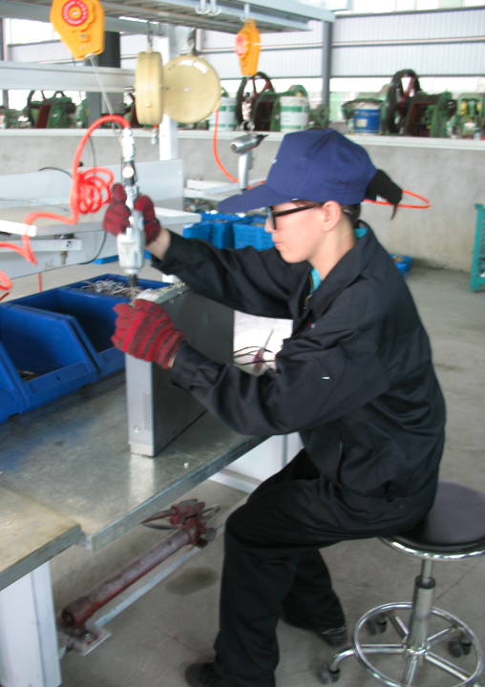
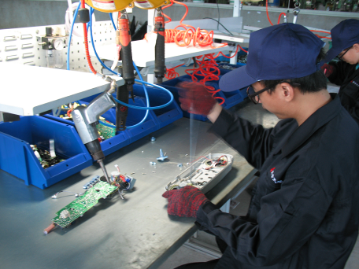
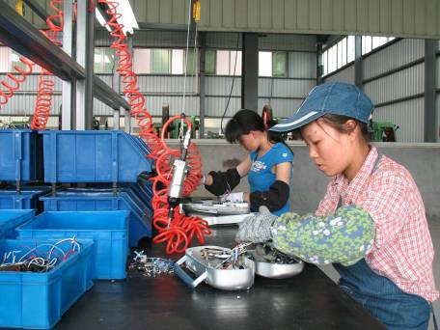
Afgelopen maandag
8

Slide 9
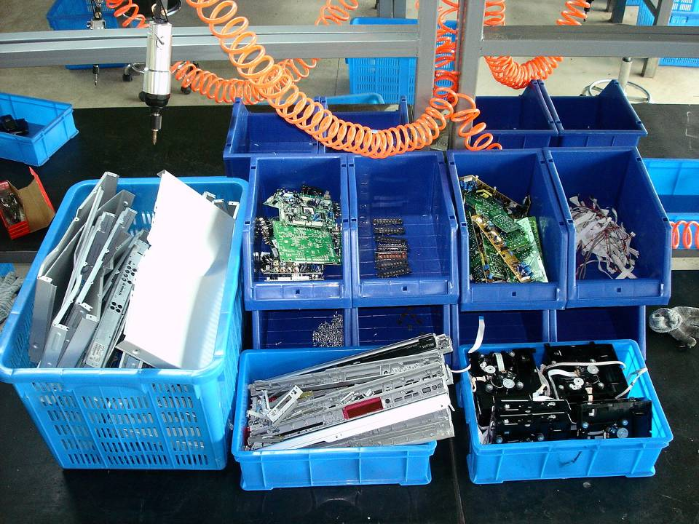
9

Slide 10
Documented and reported collection percentage of e-waste generated
EU: ± 40%
Japan: ± 40%
USA+CAN: ± 11%
China: ± 5%
Australia: ± 1%

Slide 11
Flows are largely undocumented…
??? %
??? %
??? %
??? %

Slide 12
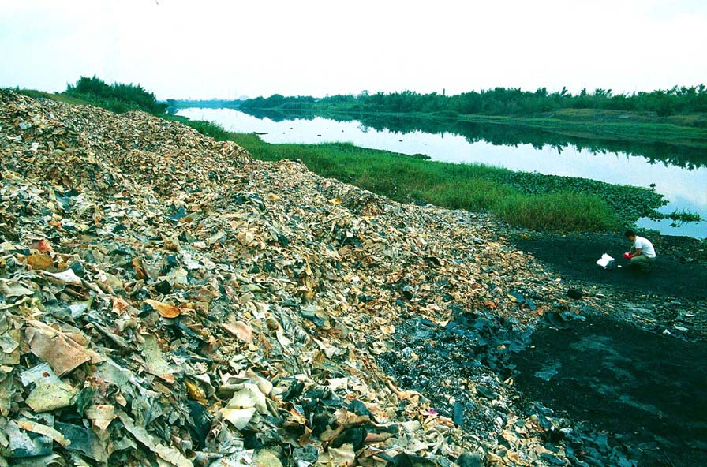
Informal recycling in very poor African countries
Notes:
Due to decreasing life spans, minituarisation in design, recycling becomes even harder.
In the current reality → hazardous substances are released when treated improperly

Slide 13
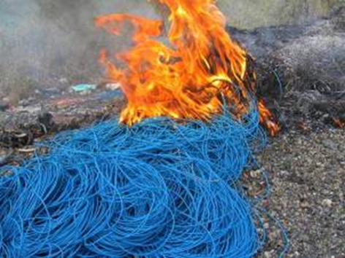

Slide 14
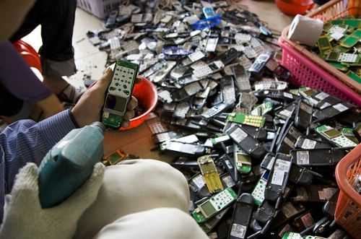
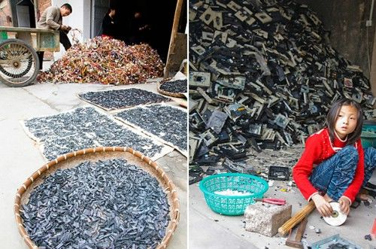
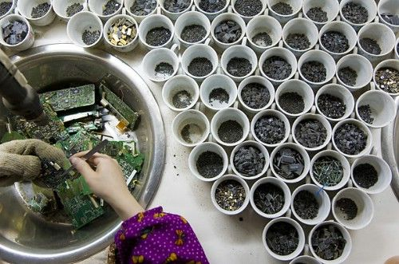
Informal recycling techniques in China
Labour intensive in manual dismantling, sorting
  Use of simple tools and techniques
Reuse:
  Batteries, cartridges, power supplies, cables, circuit boards and chips etc.
Material recycling:
  Precious metals (acid stripping), ferrous and non-ferrous metals and plastics
Limited technologies and equipment
No occupational protection, no emission control measures

Slide 15
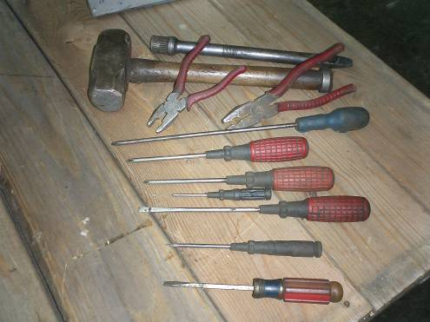
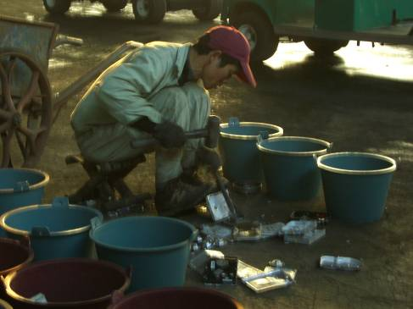
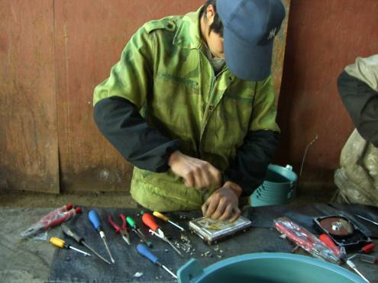
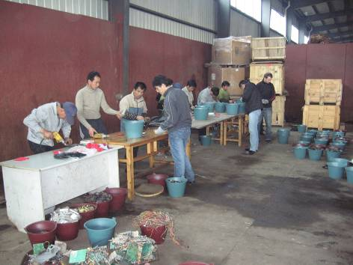

Slide 16
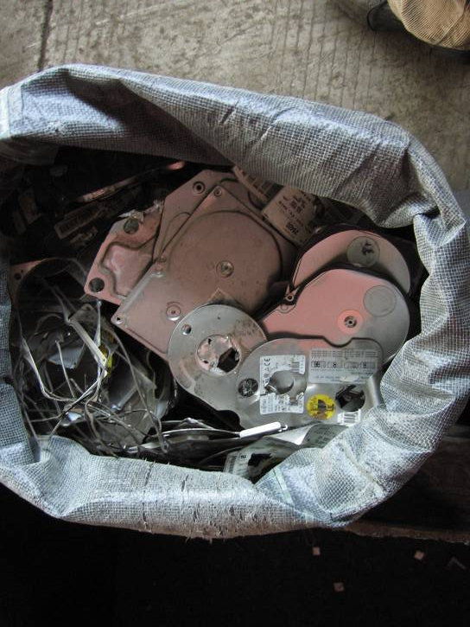
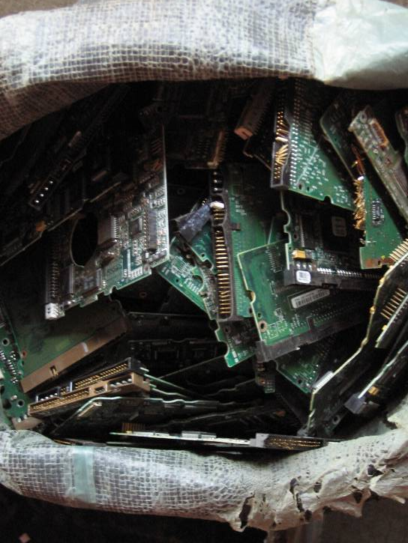

Slide 17
Impact on health
Exposure to lead
  Mental development of children, toxic to kidneys
When burning PVC → dioxins
  One of the most hazardous carcinogens (cancer)
Hexavalent Chromium
  Kidney, liver, DNA
Brominated Frame retardants
  Fetal damage
Cadmium
  Cancer, toxic to kidneys
Source: e-stewards.org/the-e-waste-crisis

Slide 18
Resource and job potential
At least 57 elements:
Materials
Base metals
Precious metals
Rare earth metals
Plastics
Glass
....
Hazardous materials
Mercury
CFCs
Lead
Flame retardants
....
Nicht gleich Wert
Nicht gleich Wert

Slide 19

Challenges vs. opportunities in emerging economies for e-waste
19
Lack of investment and technology
Lack of formal collection system
Lack of financing schemes
Lack of national e-waste legislations
Presence of the informal sector
Growing e-waste streams (domestic and import)
Challenge
Opportunity
(Relative) low labor cost
Available technological know-how
and management experience
Create jobs + create revenue

Slide 20
Role of Government
Ministry of Environment
  Formulate law
  Monitoring of e-waste volumes
  Define Collection targets
    E-waste collected vs. e-waste generated
  Minimum recycling standards of collected e-waste
  Enforce
Environmental inspection
  Basel Convention
    Inspection of shipments (illegal imports from OECD countries)
  Inspect on inferior recycling standards

Slide 21
Private sector involvement
Extended producer responsibility
  Importer or producer is responsible for proper recycling of e-waste
  Set up collection of e-waste
  Set recycling standards
  Can be financed via visible fee upon sale reflecting recycling costs
    Fridge: 8 euro, TV 2 euro, etc.
    E-waste recycling is also profitable in EU for most categrories

Slide 22
Data monitoring
National Statistics Institute or Environmental Protection Agency
  Sales – household statistics (possession studies), and household expenditure statistics
  Sales (Apparent consumption approach): Domestic Production + Import - Export
  Waste Statistics – waste collection
  Data is independently measured: with a purpose for to measure target in e-waste laws

Slide 23
How to measure e-waste?
Sales
  Stays in household (lifetime)
E-waste generated
  Sales after use phase (lifetime period).
Separate e-waste collection
  Compliant with national law
Collection with other wastes
  Other recycling (with metal scrap, lower quality recycling)
  Waste Bin (bad consumer behaviour)
Indicators
  Total Sales (kg/inh)
  Total waste generated (kg/inh)
  E-waste collection rate = Separate E-waste collection / e-waste generated

Slide 24

Formulated in E-waste guidelines
Guide countries to measure relevant parameters
  http://ias.unu.edu/en/research/e-waste-quantification.html#outputs

Slide 25
EECCA countries
1.9 Mt of e-waste in total region in 2014
Annual growth rate: 5%
Gold: Worth 560 million Euro annually
Other valuables: ± 1800 million euro annually
http://www.step-initiative.org/index.php/WorldMap.html
1-3 kg/inh
3-5 kg/inh
5-7 kg/inh
7-9 kg/inh

Slide 26
% of population covered with regulations on e-waste

Slide 27
What else can UNU offer: Example Kazakhstan
(unit: kt)
Country |  | YEAR | 2014
Kazakhstan | E-waste generated | Total | 126
 |  | Lamps | 2
 |  | Large Equipment | 32
 |  | Screens | 18
 |  | Small Equipment | 48
 |  | Small IT | 6
 |  | Cooling and Freezing equipment | 15
Steady 6 to 7 % yearly Growth rate
126 million kg of e-waste per year in Kazakhstan
Worth 31 million USD of gold in this e-waste

Slide 28
Separate collection of e-waste
Unknown for all EECCA countries so far …

Slide 29
Raise hands
Questions
  1) Are there regulations on E-waste?

Slide 30
Raise hands
Questions
  1) Are there regulations on E-waste?
  2) Is there data on sales in your country
1-3 kg/inh
3-5 kg/inh
5-7 kg/inh
7-9 kg/inh

Slide 31
Raise hands
Questions
  1) Are there regulations on E-waste?
  2) Is there data on sales in your country
  3) Is there data on separate E-waste collection in your country?
Unknown data

Slide 32
Ideas for potential project
Data validation
Data gathering on collection of e-waste
Impact assessment
  Recycling performance of e-waste
  Recycling potential of e-waste (urban mine)
  Creation of green jobs in recycling
  Environmental burden
  Societal impact
Raise hands if interested
Please give us feedback on your thoughts…is it interesting for your country?

