Slide 1
Informal document GRB-67-08
(67th GRB, 24-26 January 2018,
agenda item 6)
Transmitted by the expert from ETRTO
ASSESSMENT OF THE LATEST PROPOSAL
BY THE NETHERLANDS AS PRESENTED
DURING THE LAST 66th SESSION OF GRB
January 22nd, 2018

Slide 2
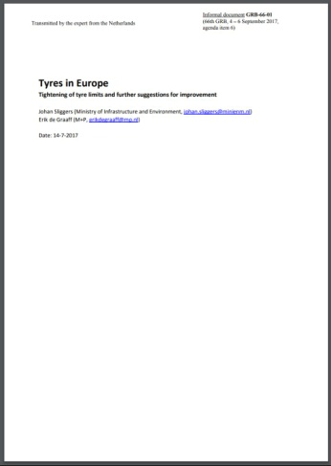
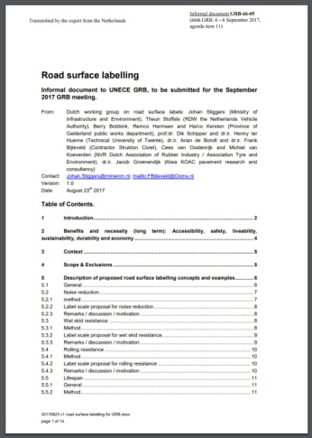
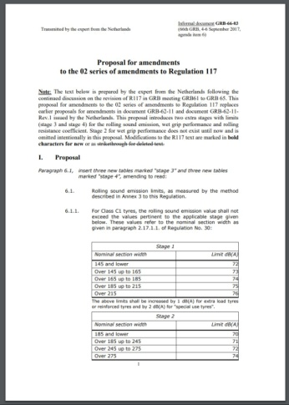
Documents presented by the Netherlands during the 66th GRB
GRB-66-01 Tyres in Europe
GRB-66-03 Proposal for amendments to the 02 series of amendments to Regulation No. 117
GRB-66-05 Road surface labelling
The following analysis will only address the tyre limits proposed in documents GRB-66-01 and GRB-66-03

Slide 3
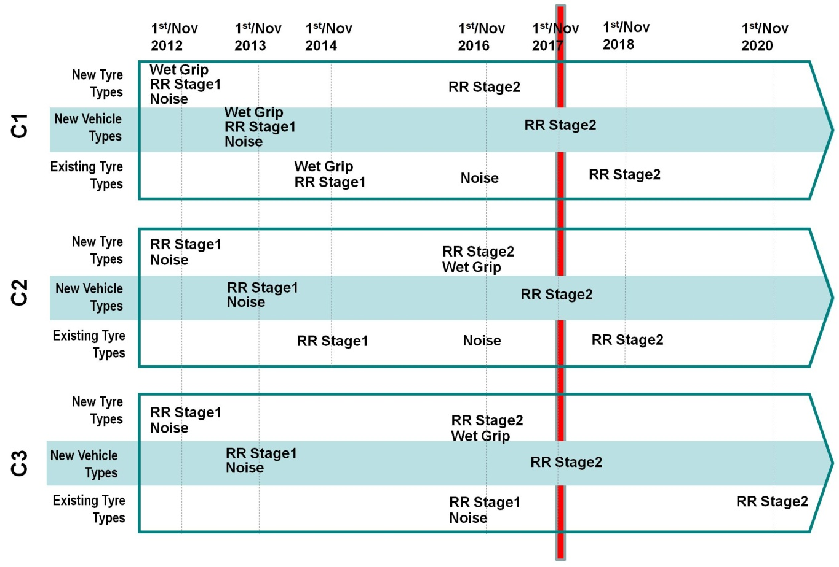
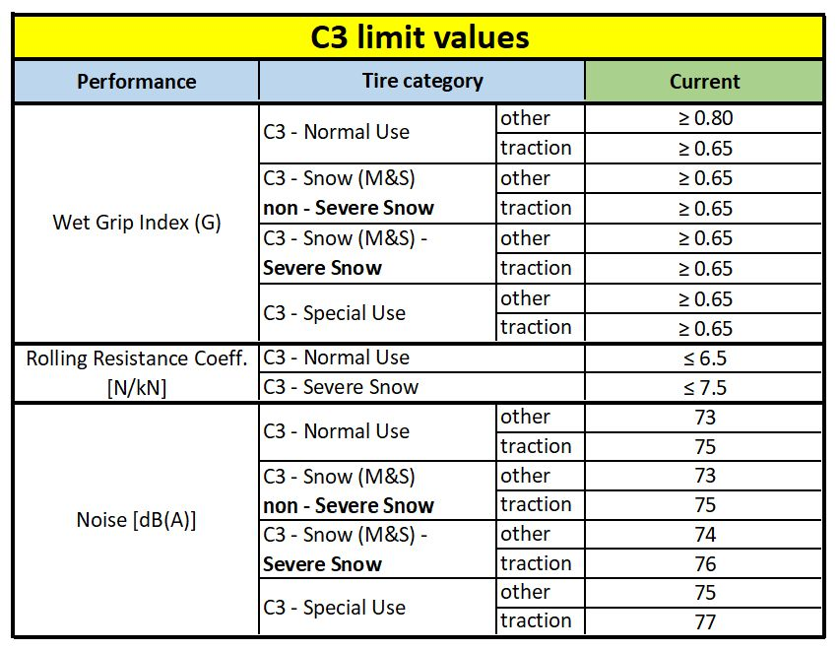
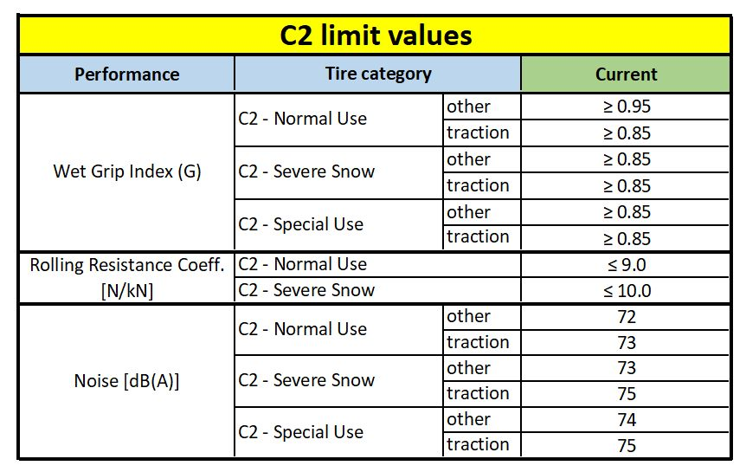
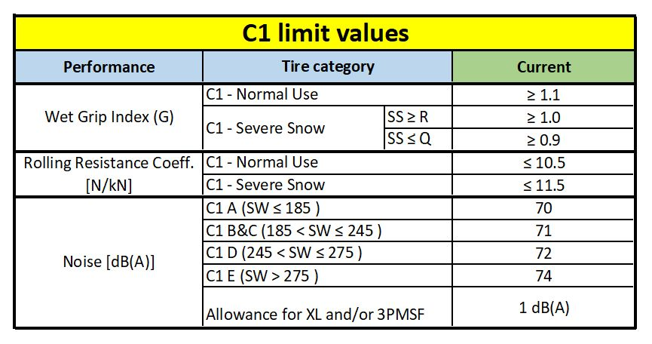
Current limits and timeline in EU REGULATION (EC) No 661/2009
EU Regulation (EC) No 661/2009 is directly linked to
UN Regulation No 117.02

Slide 4
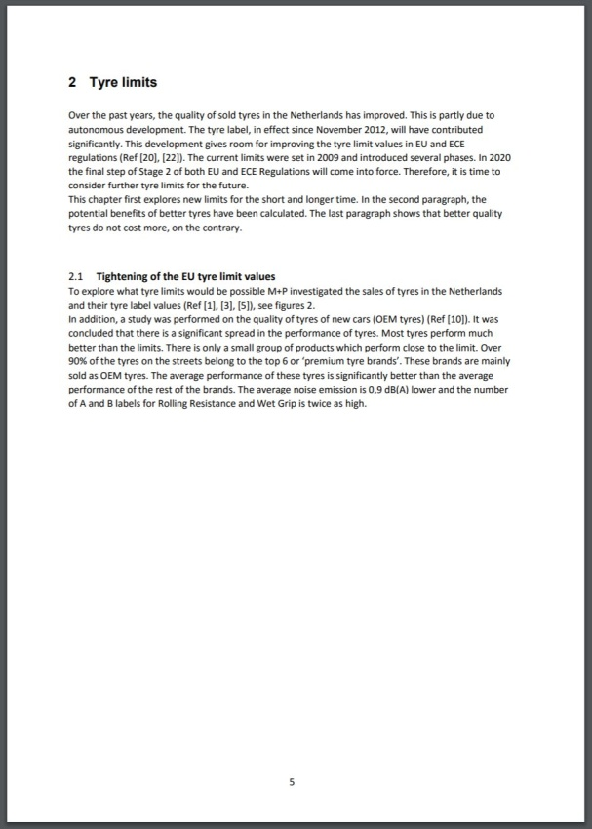
Extract GRB-66-01
2.1 Tightening of the EU tyre limit values
To explore what tyre limits would be possible M+P investigated the sales of tyres in the Netherlands and their tyre label values (Ref [1], [3], [5]), see figures 2.
Based on the outcome of these research projects one could imagine two further stages of tightening the tyre limits. The suggested limits for the short term could be set such that around 50% of the tyres sold in 2016 would comply with the limits as given in Stage 3. One could say that Stage 3 limits would follow technology. The top 20% of the tyres sold in 2016 would be the basis for the suggested limits for the longer term as given in Stage 4. Stage 4 limits would push technology. These percentages are taken from the data analysis of 2016 tyre label data (see figure 2). The affiliated percentage of compliant tyres, following Dutch statistics1, are given in table I, table II and table III.
1 Note: although the used statistics are Dutch, the market in the Netherlands reflects the European market. The data are in agreement with data from Denmark (Danish Road Safety Agency, 15th July 2016, reaction to the Commission after the 132nd meeting of the WGMV, 5th July 2016))
[1] GRB-59-11 - (The Netherlands) Tyre noise data.
[3] GRB-60-08 - (Netherlands) Tyre noise limits of EC/661/2009 and ECE R117: Evaluation based on sold tyres in the Netherlands
[5] GRB-60-12 and GRB-60-08-Add.1 - (Netherlands) Shifts in tyre sound levels between 2007 and 2013

Slide 5
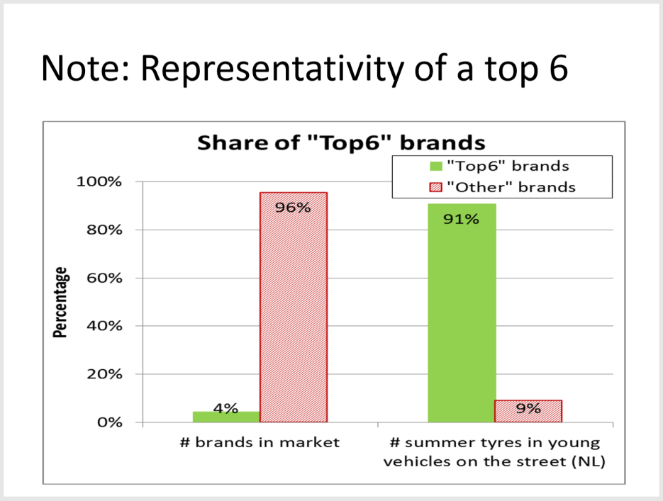
Extract GRB 62-11-Rev.1

Slide 6
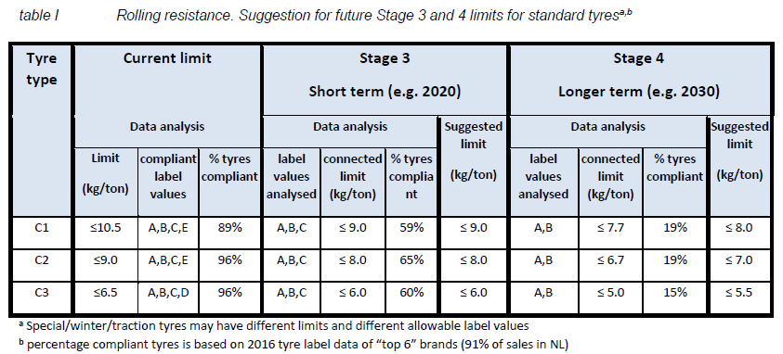
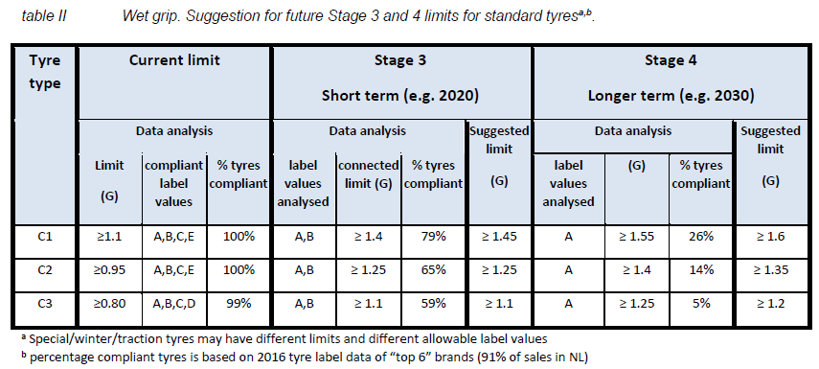
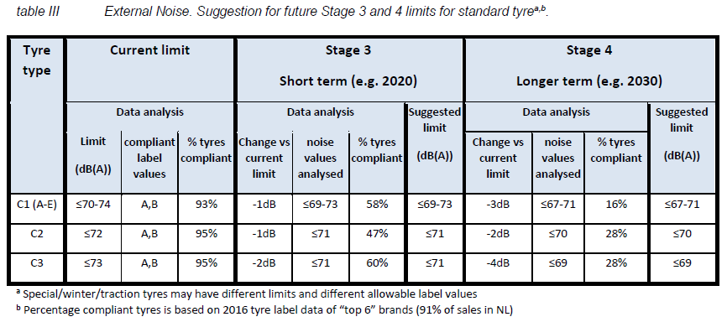
New Limits and Data Selection as taken from GRB-66-01
percentage of compliant tyres is based on 2016 tyre label data of “top 6” brands (91% of sales in NL)
NOT A SIGNIFICATIVE SAMPLE!
(see next slide)

Slide 7
Representativeness of C1 data used by NL study
C1 tyres in 1958 Agr. Contracting Parties Countries
C1 database of EU market (≈60000 labels)
C1 database of NL market (VACO)
(>20000 labels = 100%)
C1 tire subset
(760 labels = 3.8%)
96.2% of labels on the NL market in sizes and of brands which are not considered in the subset

Slide 8
Data validity
Data correctness for 3PMSF marking in the VACO database has been analyzed.
For example, within ETRTO Members a check was done and the following resulted for C3 tyres: 21% of all 1084 checked tyres have a wrong 3PMSF marking in the VACO database.
INACCURACIES EXIST AND NEED TO BE CONSIDERED

Slide 9
Data validity
The VACO database does not indicate which C2 and C3 tyres are “TRACTION” marked. The study presented by the Netherlands (GRB-60-03) assumes that tyres which are intended for use on the “drive axle” have the “Traction” marking. This assumption leads to a significant overestimation of the number of “Traction” marked tires. The impact of this inaccuracy needs to be considered.
Assumption in NL study: 49.5 % of all C3 tyres have “Traction” marking and get a 2 dB(A) noise allowance
Validation by ETRTO members: 25.2% of the 1084 checked C3 tyres from the VACO database (April 2017) have in reality a “Traction” marking
WRONG ASSUMPTIONS WILL CREATE WRONG CONCLUSIONS

Slide 10
C1 current limits VS proposal for a new Stage 3
The claim in GRB-66-03 “The proposed limits are technically achievable, as in 2016 around 50% of the new tyres meet the limits proposed.” cannot be confirmed.
DIFFERENCE BETWEEN CURRENT LIMITS AND WHAT PROPOSED FOR A NEW STAGE 3
Based on VACO database (April 2017)
Only 15.5 % (3141 out of the 20220) of the C1 tires meet the proposed Stage 3 limits

Slide 11
C1 current limits VS proposal for a new Stage 4
Only 0.9 % (180 out of the 20220) of the C1 tires meet the proposed Stage 4 limits
DIFFERENCE BETWEEN CURRENT LIMITS AND WHAT PROPOSED FOR A NEW STAGE 4
Based on VACO database (April 2017)
MORE THAN 99% OF CURRENT MARKET WOULD BE ELIMINATED

Slide 12
C2 current limits VS proposal for a new Stage 3
The claim in GRB-66-03 “The proposed limits are technically achievable, as in 2016 around 50% of the new tyres meet the limits proposed.” cannot be confirmed.
DIFFERENCE BETWEEN CURRENT LIMITS AND WHAT PROPOSED FOR A NEW STAGE 3
Based on VACO database (April 2017)
Only 19.8 % (460 out of the 2318) of the C2 tires meet the proposed Stage 3 limits

Slide 13
C2 current limits VS proposal for a new Stage 4
Only 2.3 % (54 out of the 2318) of the C2 tires meet the proposed Stage 4 limits
DIFFERENCE BETWEEN CURRENT LIMITS AND WHAT PROPOSED FOR A NEW STAGE 4
Based on VACO database (April 2017)
MORE THAN 97% OF CURRENT MARKET WOULD BE ELIMINATED

Slide 14
C3 current limits VS proposal for a new Stage 3
The claim in GRB-66-03 “The proposed limits are technically achievable, as in 2016 around 50% of the new tyres meet the limits proposed.” cannot be confirmed in its entirety.
DIFFERENCE BETWEEN CURRENT LIMITS AND WHAT PROPOSED FOR A NEW STAGE 3
Based on VACO database (April 2017)
47.2 % (551 out of the 1168) of the C3 tires meet the proposed Stage 3 limits*
* Specific detailed analyses should be made to assess the proposed limits within specific applications / axle fitment

Slide 15
C3 current limits VS proposal for a new Stage 4
Only 8.0 % (93 out of the 1168) of the C3 tires meet the proposed Stage 4 limits
DIFFERENCE BETWEEN CURRENT LIMITS AND WHAT PROPOSED FOR A NEW STAGE 4
Based on VACO database (April 2017)
MORE THAN 99% OF CURRENT MARKET FOR SPECIFIC APPLICATIONS WOULD BE ELIMINATED

Slide 16
Conclusions
The claim in GRB-66-03 “The proposed limits are technically achievable, as in 2016 around 50% of the new tyres meet the limits proposed.” cannot be confirmed:
The data subset used for the NL limit proposal has some limitations:
the filters applied by NL to the database are reducing the representativeness especially considering that we need to refer to UN 1958 agreement tyre population (in terms of both size and brands);
some of the database data are not correct or inaccurate: for example some of 3PMSF or TRACTION markings are incorrectly reported.
The methodology to derive from the data subset the proposed limits, is not correct:
as overall analysis: even using the VACO database, the assessment is not analyzing each-single-tire performance: for example by accurate analysis of the data, it appears that we cannot even consider the tyre classes (C1, C2 or C3) as a whole, because doing so the specific products/applications would be neglected, and they are not interchangeable (i.e. a trailer tyre and a drive tyre cannot serve the same purpose);
as impact assessment: the size-only assessment is not taking into account the actual effect on the market, considering the market popularity of each size. There is a risk that vehicle owners will not be able to purchase new tires for their existing vehicles. A deeper data analysis will be needed also in this perspective.

